Slide 1
Practical PAPR Reduction for OFDM under PA Nonlinearity
Gavin Garrison
Modern Communication Systems
12/12/2025
Notes:
This project looks at a practical problem in wireless communication and we will cover more details in this quick presentation

Slide 2
Key Terms
OFDM – Multicarrier modulation | PAPR – Peak-to-average ratio | PA – Power amplifier
BO – Power back-off | EVM – Signal quality | BER – Bit error rate
ACLR – Adjacent-channel leakage | SNR – Signal-to-noise ratio | SLM – Selected Mapping
PTS – Partial Transmit Sequence | TR – Tone Reservation | BASE – No mitigation
Notes:
“Before getting into the results, here are the key abbreviations used throughout the presentation.
OFDM is the multicarrier modulation used in WiFi and 5G.
PAPR is the peak-to-average power ratio, which is the core issue we’re trying to reduce.
PA stands for power amplifier, and BO stands for back-off, which is how much we reduce PA input power to reduce distortion.
EVM and BER measure in-band signal quality, while ACLR measures spectral leakage.
SNR is signal-to-noise ratio, and SLM, PTS, and TR are the three PAPR reduction techniques I evaluate.”

Slide 3
Why This Matters
OFDM has large peaks that force PA back-off, reducing efficiency
Goal: maintain link quality with less PA back-off
Contribution: consistent head-to-head comparison of BASE, SLM, PTS, TR using a target-EVM view and multi-seed averaging
Notes:
OFDM signals naturally have very large peaks compared to their average power. Because real power amplifiers are nonlinear, those peaks cause distortion unless the amplifier is operated with significant back-off. That back-off directly reduces power efficiency, reduces output power, and wastes energy.”
“The goal of this project is to maintain the same link quality while using less back-off. That directly improves efficiency or extends wireless range.”
“My contribution is a clean, head-to-head comparison of several common PAPR reduction techniques using a target-EVM efficiency viewpoint with multi-seed averaging so the results are statistically meaningful.

Slide 4
What I Built
End-to-end MATLAB PA-distorted OFDM link
256 subcarriers, 16-QAM, CP 16, oversampling 4
SNR 10–30 dB, back-off 0–8 dB, 5 seeds
No equalizer, ACLR via PSD
Notes:
I built a full end-to-end MATLAB simulation of an OFDM wireless link with a nonlinear power amplifier in the transmit chain. The system uses 256 subcarriers with 16-QAM modulation, a cyclic prefix of 16, and 4× oversampling to properly capture peaks.”
“I swept SNR from 10 to 30 dB and back-off from 0 to 8 dB. Every data point is averaged over five random seeds to reduce randomness.”
“There is no equalizer enabled, so distortion from the power amplifier is not hidden. ACLR is computed from the power spectral density so we can directly measure spectral regrowth.”

Slide 5
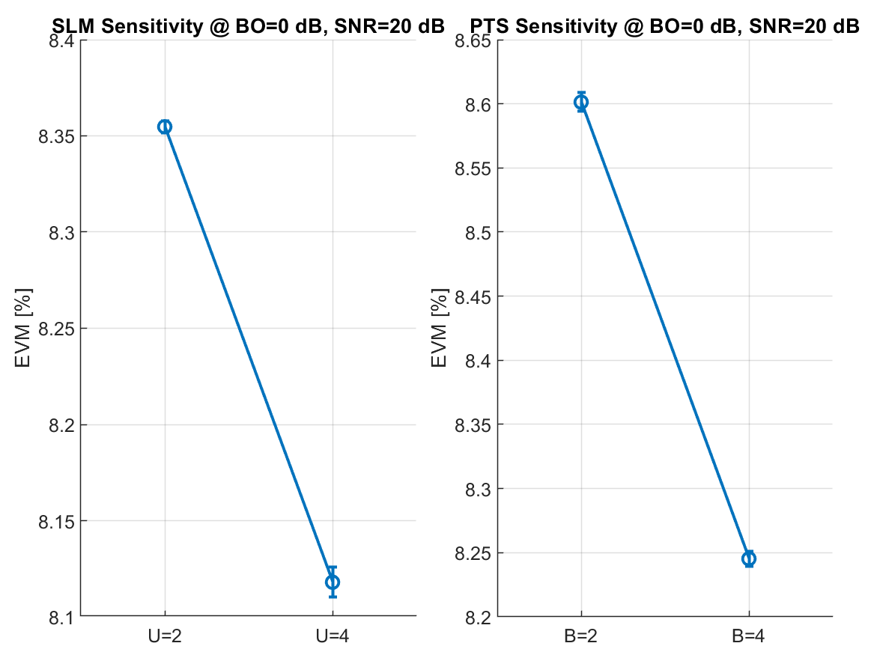
Methods Compared
Method | Key Idea
BASE | No mitigation
SLM | 4 phase candidates
PTS | 4 subblocks
TR | 10% tones reserved
Notes:
BASE is the reference with no mitigation. SLM generates multiple randomized phase versions of the same OFDM symbol and transmits the one with the lowest PAPR.”
“PTS divides the OFDM symbol into subblocks and optimizes the phase of each block to reduce peaks.”
“Tone reservation sets aside a small percentage of subcarriers that are optimized specifically to cancel peaks in the time domain.”
“The plots on the right show that increasing SLM order or PTS block count improves EVM, but with diminishing returns.”

Slide 6
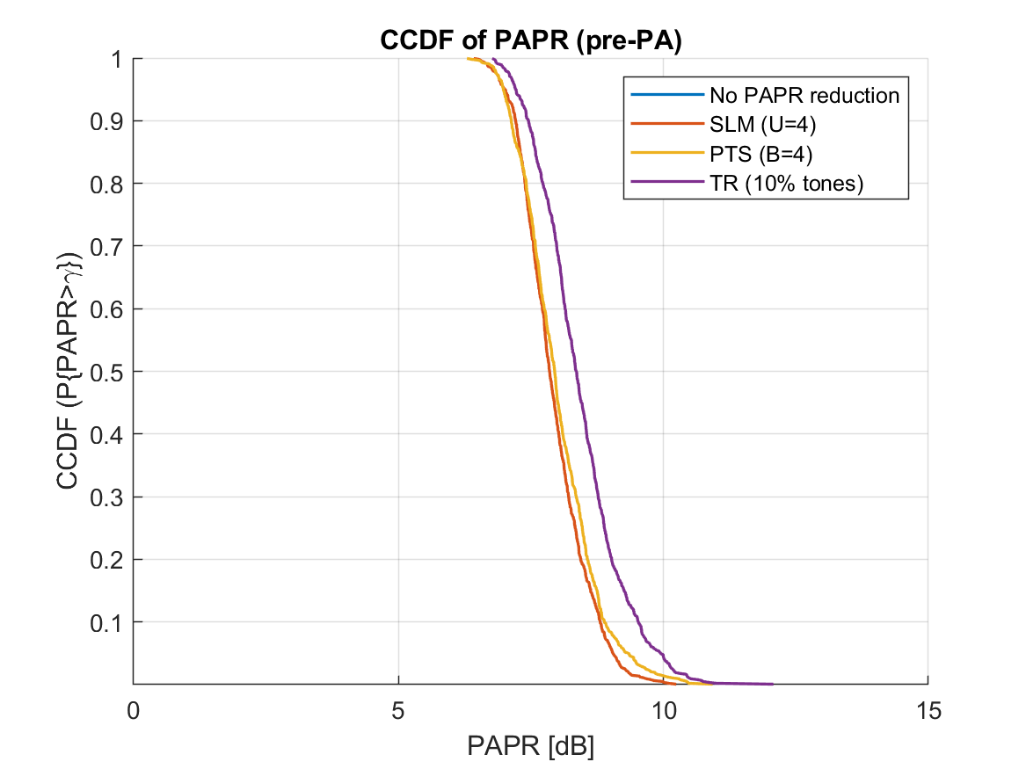
PAPR and In Band Quality
SLM and PTS reduce 0.1% PAPR tail by about 1 dB
EVM improves at fixed back-off under PA nonlinearity
BER tracks EVM with no anomalous behavior
Notes:
“This slide shows two very important results. First, SLM and PTS reduce the 0.1% PAPR tail by about 1 dB compared to the baseline. That means the worst signal peaks are physically smaller.”
“Second, at a fixed back-off, EVM is consistently improved under power amplifier nonlinearity. BER follows the same trend as EVM, with no unexpected behavior across the SNR range.”
“This confirms that PAPR reduction directly translates into better in-band signal quality under nonlinear amplification.”

Slide 7
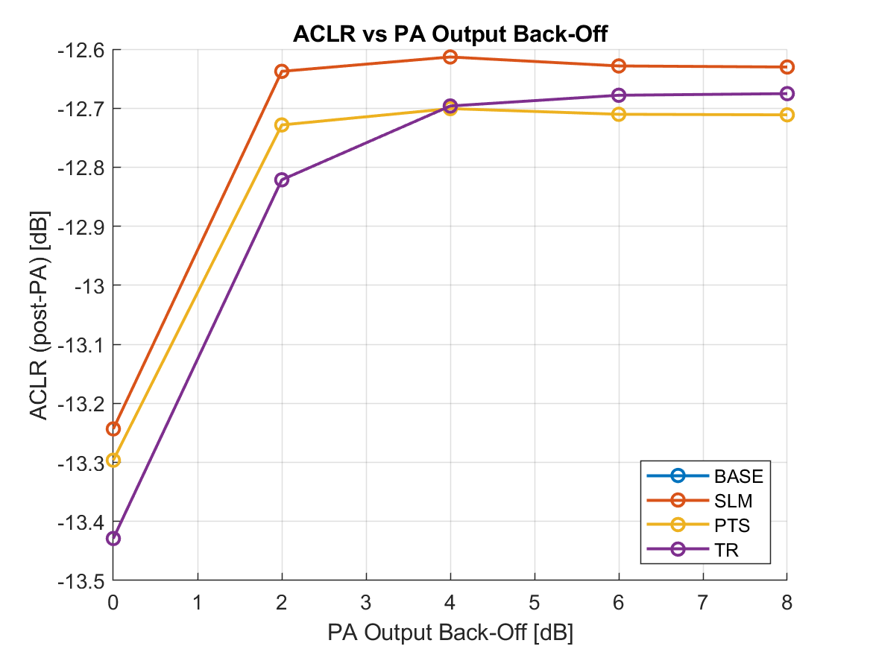
Spectral Behavior
ACLR improves monotonically with back-off
SLM, PTS, and TR introduce no spectral penalty
Adjacent-channel performance preserved with mitigation
Notes:
“Here we look at adjacent-channel leakage ratio, or ACLR. As expected, ACLR improves as back-off increases.”
“More importantly, SLM, PTS, and TR introduce no spectral penalty. In some cases they slightly improve ACLR relative to BASE because reduced peaks cause less spectral regrowth.”
“This confirms that the in-band performance gains do not come at the expense of spectral compliance.”

Slide 8
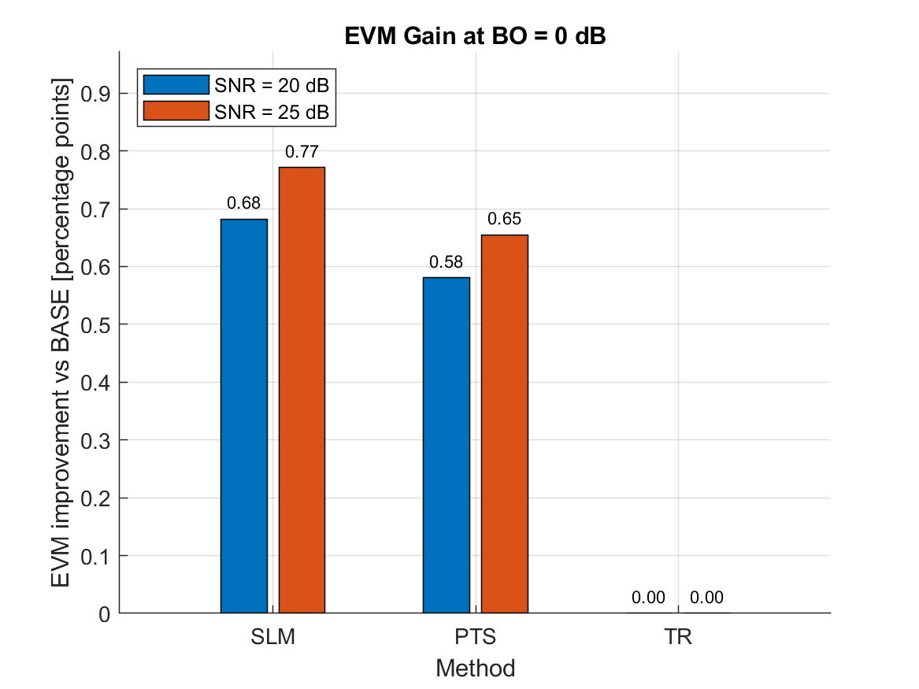
Innovation: Efficiency via Target EVM
Target EVM set to 3%
At 20 to 25 dB SNR, SLM meets target with about 1 dB less back-off than BASE
Lower back-off directly maps to higher PA efficiency or extended range
Notes:
“The innovation is a target-EVM, efficiency-based comparison of PAPR reduction methods under identical nonlinear PA conditions, with statistical averaging to quantify real transmitter benefit.
This slide shows performance using a target EVM of 3 percent. The bars indicate how much EVM improvement each method provides at zero back-off for SNR values of 20 and 25 dB.”
“At these SNRs, SLM provides the largest improvement over the baseline, with PTS giving a smaller gain and tone reservation showing no effect in this configuration.”
“These improvements correspond to roughly 1 dB less required back-off to meet the same EVM target, which directly translates to higher power amplifier efficiency or increased transmit range.”
Typical work
Fix PA back-off
Plot EVM vs SNR
Or plot CCDF(PAPR)
Implicit assumption: lower PAPR automatically helps
Your work
Fix EVM requirement (communication quality)
Ask: what is the minimum back-off needed to meet it?

Slide 9
Limitations and Takeaways
No PA memory, multipath off, 16-QAM only
Diminishing returns for higher SLM and PTS order
Add multipath, EQ, 64-QAM, runtime, and TR placement
Bottom line is about 1 dB back-off reduction at equal EVM
Notes:
“There are a few limitations to this study. The power amplifier model has no memory effects, multipath is disabled, and only 16-QAM is evaluated.”
“Both SLM and PTS show diminishing returns as their order increases.”
“Next steps include enabling multipath, adding equalization, testing 64-QAM, analyzing runtime complexity, and optimizing tone reservation placement.”
“The bottom line is that achieving about a 1 dB back-off reduction at equal EVM is a meaningful efficiency improvement.”

Slide 10
Questions?
Notes:
1. Why does OFDM have high PAPR?
Answer:
Because OFDM adds many subcarriers together in the time domain. When many sinusoids align in phase, they create large peaks compared to the average signal power.
2. What is back-off and why is it needed?
Answer:
Back-off is reducing the PA input power so the PA stays in its linear region. It prevents nonlinear distortion, protects EVM/BER, and limits spectral regrowth.
3. What exactly improves when you reduce PAPR?
Answer:
Lower peaks → less time spent in the nonlinear region of the PA → better EVM, lower BER, lower spectral regrowth, and the ability to operate with less back-off, improving PA efficiency.
4. Why is a 1 dB improvement meaningful?
Answer:
PA efficiency rises steeply near saturation. Saving 1 dB of back-off can increase PA efficiency by 5–10% and increase usable transmit power by ~25%.
5. Why does SLM outperform PTS and TR?
Answer:
SLM applies global phase randomization and selects the lowest-PAPR candidate.
PTS only optimizes block phases, and TR was limited because only 10% of tones were reserved.
6. Why does TR show almost no EVM improvement in your results?
Answer:
With only 10% reserved tones, TR doesn’t have enough degrees of freedom to significantly cancel peaks. It reduces rare peaks slightly, but not enough to change the PA’s nonlinear distortion at BO = 0 dB.
7. Why did you disable the equalizer?
Answer:
An equalizer can hide nonlinear PA distortion. Keeping it off ensures the results directly reflect PAPR reduction performance under nonlinearity.
8. Why choose a 3% EVM target?
Answer:
3% is a standard quality threshold for 16-QAM, consistent with real wireless specifications (e.g., WiFi, LTE). It provides a meaningful reference point.
9. How do your results relate to real hardware?
Answer:
Trends remain the same: reducing PAPR lowers PA distortion and allows for lower back-off. The exact numbers vary by PA type, but the behavior is realistic.
10. What is the main takeaway of your entire study?
Answer:
SLM and PTS reduce PAPR enough to save about 1 dB of required back-off at equal EVM, with zero spectral penalty. This translates to higher PA efficiency in real transmitters.
1. Why does reducing PAPR actually improve EVM under a nonlinear PA?
Answer:
High PAPR signals spend more time near the PA’s saturation region, where AM/AM compression is strongest. This nonlinear distortion spreads energy across constellation points, increasing EVM. By reducing rare but extreme peaks, PAPR reduction keeps more samples in the quasi-linear region, reducing distortion and improving EVM.
2. Why does SLM outperform PTS in your results?
Answer:
SLM explores multiple globally phase-rotated candidates and selects the lowest-PAPR waveform, giving more degrees of freedom per OFDM symbol. PTS is constrained by block partitioning and a greedy phase search, which limits how well it can suppress global peaks.
3. Why does Tone Reservation (TR) show little or no improvement?
Answer:
TR effectiveness depends on the number of reserved tones and the cancellation algorithm. With only 10% reserved tones and a single-shot least-squares solution, TR has limited freedom to suppress large peaks, so its PAPR tail and PA distortion remain close to the BASE case.
4. Is a 1 dB improvement in back-off actually meaningful?
Answer:
Yes. PA efficiency scales exponentially with back-off. A 1 dB reduction can translate to roughly 20–25% improvement in power efficiency or equivalent range extension, which is significant in battery-powered or high-power RF systems.
5. Why did you focus on the 0.1% CCDF point instead of average PAPR?
Answer:
Rare high peaks dominate PA compression and spectral regrowth. The 0.1% tail better captures worst-case behavior that drives EVM and ACLR, whereas average PAPR underestimates the impact of extreme peaks.
6. Why did you disable receiver equalization?
Answer:
Equalization can partially undo nonlinear distortion and mask differences between PAPR reduction methods. Disabling it isolates the transmitter-side effects and makes EVM differences attributable primarily to PA nonlinearity.
7. Why use multi-seed averaging instead of a single run?
Answer:
OFDM PAPR and EVM vary significantly with random data and noise. Multi-seed averaging reduces statistical bias and provides uncertainty estimates, making comparisons more robust and reproducible.
8. Why does ACLR improve with increasing back-off for all methods?
Answer:
Higher back-off pushes the PA toward its linear operating region, reducing spectral regrowth caused by nonlinear distortion. This behavior is independent of the PAPR method and reflects fundamental PA characteristics.
9. Why doesn’t PAPR reduction significantly hurt ACLR or BER?
Answer:
SLM and PTS preserve orthogonality and constellation structure, only modifying phases. TR uses reserved tones outside data subcarriers. As a result, in-band distortion and adjacent-channel leakage are not increased and may even improve slightly.
10. Why did you choose 16-QAM instead of higher-order modulation?
Answer:
16-QAM provides a clear baseline where PA distortion effects are visible without being dominated by noise sensitivity. Higher-order modulations would amplify EVM sensitivity but follow the same qualitative trends.
11. Why is oversampling necessary in your OFDM modulation?
Answer:
Oversampling captures inter-sample peaks that would otherwise be missed. Without oversampling, PAPR would be underestimated and PA distortion effects would not be accurately modeled.
12. Why does SLM performance saturate when increasing U from 2 to 4?
Answer:
Additional candidates improve peak suppression initially, but diminishing returns occur once the lowest achievable peak distribution is reached. Beyond that, extra candidates rarely produce significantly better waveforms.
13. Is your PA model realistic?
Answer:
It is a memoryless soft-limiting AM/AM model, which captures first-order nonlinear behavior. While it does not include memory effects or AM/PM distortion, it is sufficient to demonstrate relative performance trends between PAPR methods.

Slide 11
References:
[1] S. Weinstein and P. Ebert, “Data transmission by frequency-division multiplexing using the discrete Fourier transform,” IEEE Transactions on Communication Technology, vol. 19, no. 5, pp. 628–634, Oct. 1971.
[2] R. van Nee and R. Prasad, OFDM for Wireless Multimedia Communications. Boston, MA, USA: Artech House, 2000.
[3] S. H. Han and J. H. Lee, “An overview of peak-to-average power ratio reduction techniques for multicarrier transmission,” IEEE Wireless Communications, vol. 12, no. 2, pp. 56–65, Apr. 2005.

